Slide 1
Wood Joints
Woodworking 1
Mr. Karlsven

Slide 2
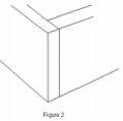

Slide 3
Butt Joint

Slide 4
Butt Joint
WEAK

Slide 5
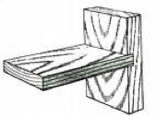

Slide 6
Dado Joint

Slide 7
Dado Joint
MEDIUM

Slide 8
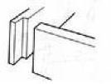

Slide 9
Rabbet Joint

Slide 10
Rabbet Joint
MEDIUM

Slide 11
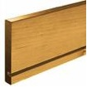

Slide 12
Groove or Plough Joint

Slide 13
Groove or Plough Joint
STRONG

Slide 14
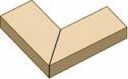

Slide 15
Miter Joint

Slide 16
Miter Joint
WEAK

Slide 17
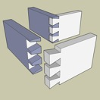

Slide 18
Dovetail Joint

Slide 19
Dovetail Joint
STRONG

Slide 20
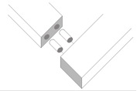

Slide 21
Dowel Joint

Slide 22
Dowel Joint
STRONG

Slide 23
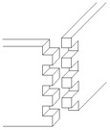

Slide 24
Box Joint

Slide 25
Box Joint
STRONG

Slide 26
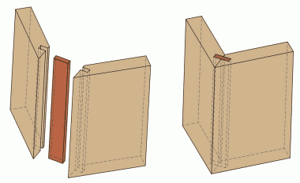

Slide 27
Spline Joint

Slide 28
Spline Joint
MEDIUM

Slide 30
Biscuit Joint

Slide 31
Biscuit Joint
STRONG

Slide 33
Mortise and Tenon Joint

Slide 34
Mortise and Tenon Joint
STRONG

Slide 36
Lap Joint

Slide 37
Lap Joint
STRONG

